Slide 1
Health Risk Analysis using Machine Learning and
Environmental Data
Presented By:
Priyanshi Mehta | Roll No: 2023Btech061
Supervisor: Dr. Amit Sinhal
Department of Computer Science & Engineering

Slide 2
I N T R O D U C T I O N
Why This Project?
The Problem
Air pollution is one of India's biggest public health challenges. Cities like Delhi, Patna, and Gurugram regularly cross dangerous AQI levels. Millions of people face serious respiratory and cardiovascular risks every day due to industrial emissions, vehicle exhaust, and seasonal crop burning.
The Gap
CPCB monitors and publishes AQI data - but it is just raw numbers. It is not interactive, not easy to understand, and gives no health guidance.
Our Solution
We developed an AI-based Air Quality and Health Risk Monitoring Dashboard that transforms complex environmental data into simple visual insights - combining data visualization and machine learning to improve pollution awareness and support better decision-making for public health.
Helps: Government Authorities | Doctors & Healthcare Workers | Citizens & Travellers

Slide 3
LITERATURE REVIEW
Research Papers
Reference
Methodology
Gap / Limitation
Gupta & Kumar (2023)
ML models for AQI prediction
Limited models, no deep learning
Kumar et al. (2024)
Regression-based PM2.5 prediction — Delhi
Location-specific, no hybrid models
Singh & Suthar (2025)
Random Forest + Linear Regression — Jaipur
No real-time prediction.
Zhang et al. (2020)
LSTM deep learning for pollution prediction
High complexity, low explainability
Devarakonda et al. (2018)
SVM, Decision Tree — real-time AQI
Limited features, no health risk analysis

Slide 4
OBJECTIVE • RESEARCH GAPS • OUR APPROACH
Objective, Gaps & Our Approach
Objective
Air pollution poses a serious public health threat in Indian cities. The objective is to analyze large-scale air quality data, classify health risk levels using Machine Learning, and provide actionable insights through an interactive real-time dashboard.
Research Gaps in Existing Work
What We Are Doing
Limited to single location, no multi-city analysis
01
Multi-city AQI analysis across 10+ Indian cities
No integration of health risk categorization
02
ML model to classify pollution-based health risk
Deep learning models lack explainability
03
Interactive Streamlit dashboard for visualization
No real-time data or forecasting support
04
Future: real-time data + 7-day AQI forecasting
Isolated models no hybrid approaches used
05
Deep learning (LSTM, XGBoost) for better accuracy

Slide 5
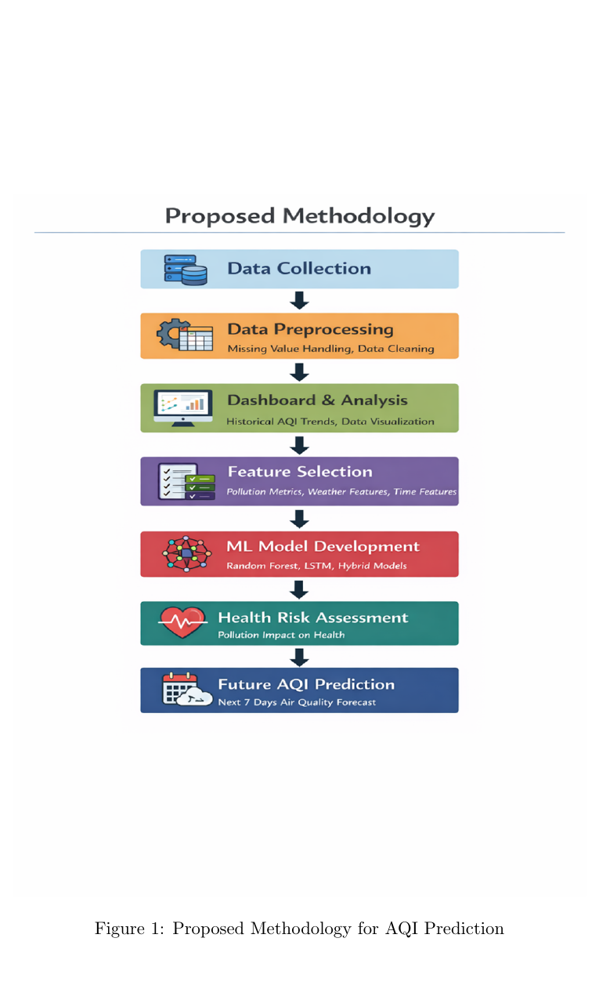
Proposed Methodology
01
Data Collection
CPCB air quality , weather data, 28 Indian cities, 2022–2025
02
Data Preprocessing
Null removal, duplicate drop, datetime parsing, feature engineering
03
EDA & Dashboard
Historical AQI trends, city comparisons, pollution visualizations
04
Feature Selection
Pollutants (PM2.5, PM10, NO2, SO2), weather, time & special features
05
ML Model — Random Forest
Ensemble classifier trained to predict AQI health risk category
06
Health Risk Assessment
Predict risk level (Good / Moderate / Unhealthy / Hazardous)
07
Future AQI Forecasting
Next 7-day AQI prediction using LSTM + real-time integration

Slide 6
Data Preprocessing & Dataset Description
Original Rows
After Null Drops
Final Columns
sage
842,160
842,015
63
Before cleaning
AQI null rows removed
After dropping columns that are not useful
Dataset Feature Categories
Location
City, State, Latitude, Longitude
Time
Datetime, Year, Month, Day, Hour, Day_of_Week, Season
Weather
Temp_2m_C, Humidity_Percent, Dew_Point_C
Wind
Wind_Speed_10m_kmh, Wind_Dir_10m, Wind_Gusts_kmh
Rainfall
Precipitation_mm, Rain_mm, Is_Raining
Atmosphere
Pressure_MSL_hPa, Surface_Pressure_hPa
Solar/Cloud
Solar_Radiation_Wm2, Cloud_Cover_Percent, Sunshine_Seconds
Pollution
PM2.5, PM10, CO, NO2, SO2, O3, Dust, AOD
AQI
US_AQI, EU_AQI, AQI_Category
Special
Temp_Inversion, Festival_Period, Crop_Burning_Season

Slide 7
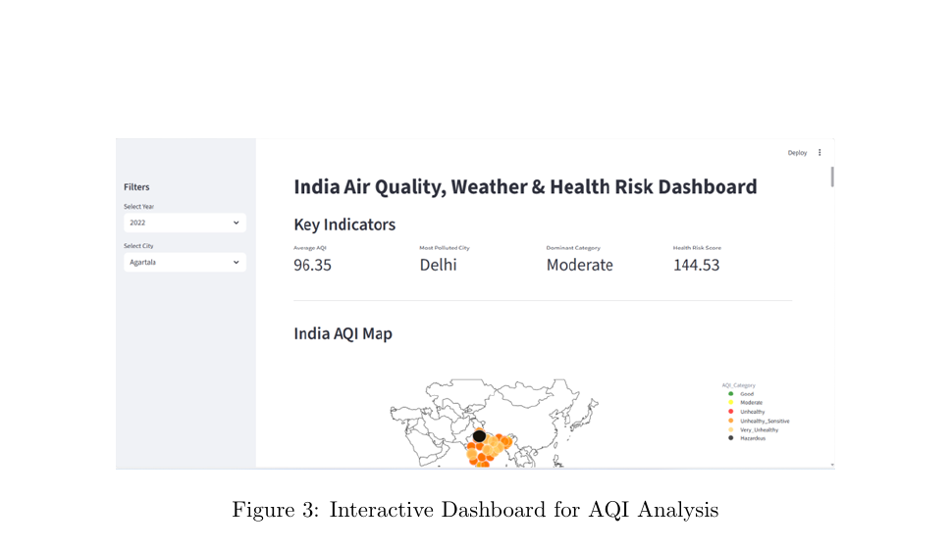
Interactive Dashboard — Analysis & Insights
What the Dashboard Analyses:
1
India AQI Map
Visualize city-wise pollution spread geographically
2
AQI Trend Over Time
Identify seasonal spikes Nov–Dec worst due to crop burning
3
Top Polluted Cities
Rank cities — Delhi (154), Gurugram (153), Patna (146)
4
Pollutant Level Analysis
Compare PM2.5, PM10, NO2, SO2 see which pollutant is highest
5
AQI Category Distribution
See hours in Good / Moderate / Unhealthy / Hazardous buckets
6
Health Risk Prediction
Predict risk level from AQI and weather input using ML model
Key Finding: PM10 highest avg concentration • Moderate AQI dominates • AQI peaks Nov–Dec • Delhi most polluted city

Slide 8
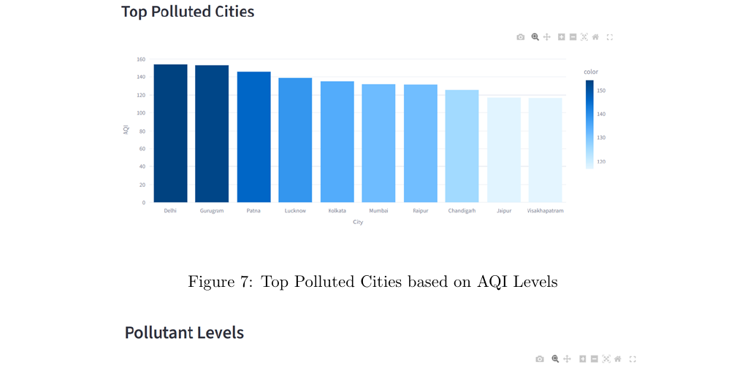
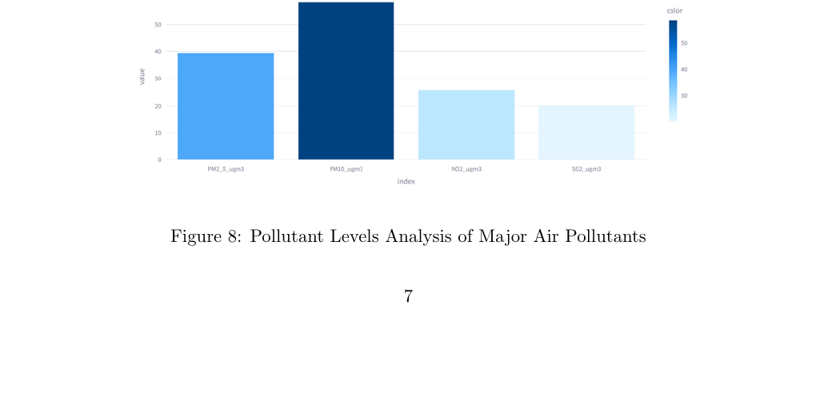
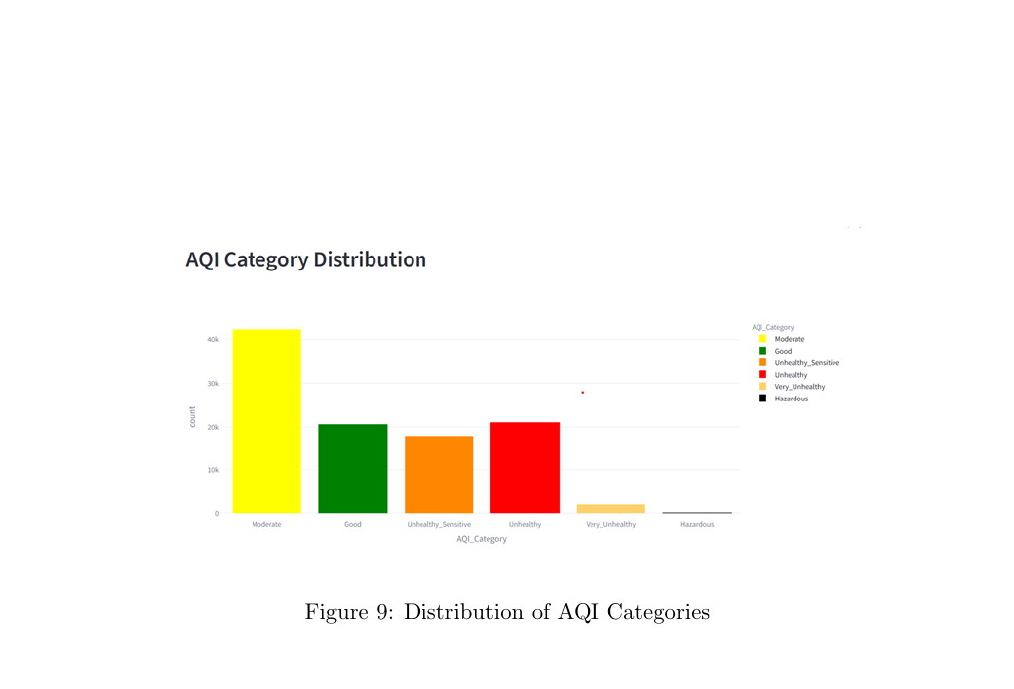
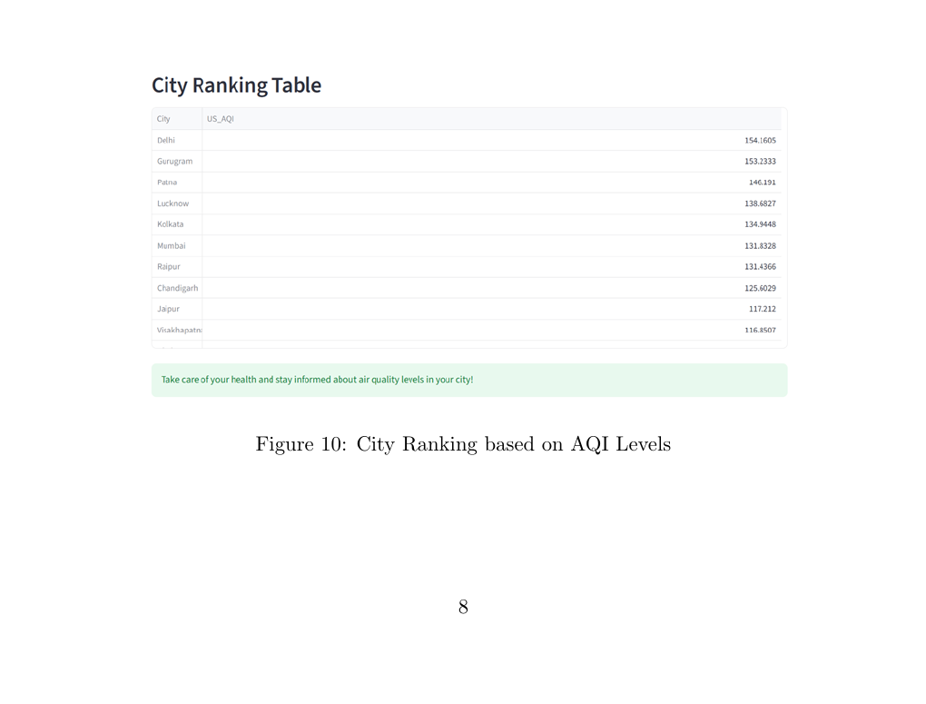
Pollution Patterns & City Rankings
Top Polluted Cities
Pollutant Levels (PM2.5, PM10, NO2, SO2)
AQI Category Distribution
City Ranking Table

Slide 9
Why Random Forest & Model Results
Model Evaluation Metrics
Ensemble of 100+ decision trees reduces overfitting
Accuracy
Precision
71.69%
71.30%
Handles non-linear relationships between pollutants & AQI
Works well with mixed feature types (numeric + categorical)
Recall
F1 Score
71.69%
71.28%
Fast training even on large datasets (842K rows)
Provides feature importance tells which pollutant matters most
Robust to outliers and missing values in weather data

Slide 10
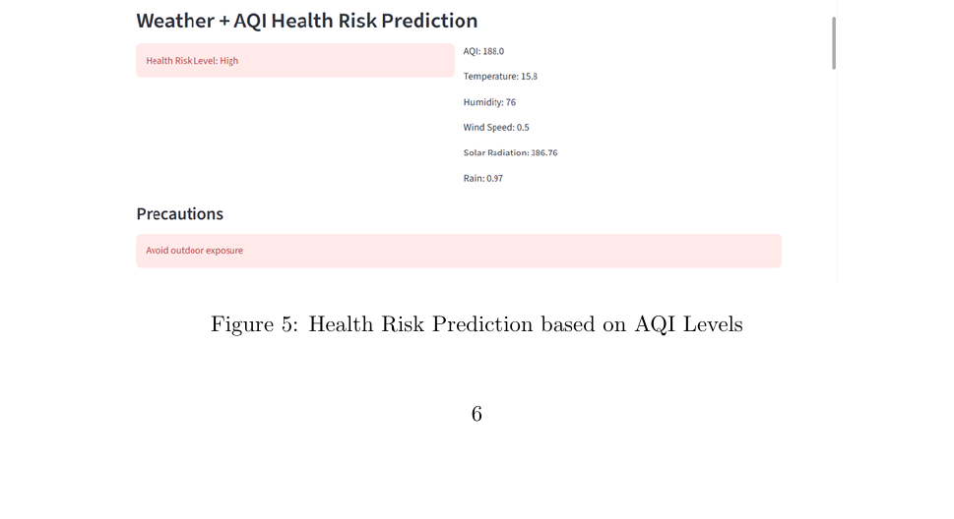
Health Risk Dashboard & Future Work
Current: Health Risk Prediction (from AQI + Weather)
How It Helps:
Predicts: Good / Moderate / Unhealthy / Hazardous
Shows precautions: 'Avoid outdoor exposure'
Helps vulnerable groups : elderly, children, patients
City-wise risk score displayed on dashboard
Future Scope
Real-Time Data Integration
7-Day AQI Forecasting (LSTM)
XGBoost + Gradient Boosting
Mobile Health Alerts
Live CPCB API feeds → dashboard updates every hour
Deep learning time-series model for next-week prediction
Better accuracy, compare with Random Forest benchmark
Push notifications when AQI crosses danger threshold

Slide 11
Conclusion
This project successfully demonstrates that Machine Learning — specifically Random Forest can analyze large-scale air quality data (842,015 records across 10+ Indian cities) and classify health risk levels with ~72% accuracy. The interactive Streamlit dashboard provides clear visualizations of AQI trends, pollutant levels, and health risks, making air quality data actionable for general users.
72% Accuracy Achieved
Delhi Most Polluted (154.16)
Random Forest classifier trained on 842K records correctly classified AQI health risk levels — Good, Moderate, Unhealthy, Hazardous.
Multi-city analysis revealed Delhi, Gurugram & Patna top polluters. AQI spikes in Nov–Dec driven by crop burning & temperature inversions.
Dashboard Built on Streamlit
Strong Foundation for Future
Interactive dashboard shows AQI map, trends, pollutant comparisons, health risk prediction & city ranking in one place.
Work completed establishes baseline for LSTM forecasting, real-time data integration, and extended health alert systems.

